Slide 1

DGS General Coding Guideline Topic: System Constants

Slide 2
6.7.3.5 System constant conditions in MSR use case
The permitted operands are the same as deﬁned in C−language.
Parentheses (also nested) may be used.
The calculation of expressions with boolean AND or OR is aborted if the ﬁrst operand has produced a result so that the total result cannot be changed anymore by the second operand (as in C).
The usual priority rule applies: multiplication and division take precedence over addition and subtraction.
The type of an arithmetic expression is internally represented either by long int, unsigned long int or by double. It will be determined by the types of its sole parts.
The division operator applied to two expressions of type signed or unsigned integer behave like the division in C for integers (integer division).
Although the common concepts instruction requires only a constant expression for DGS MEDC17 the operands of boolean operators and the result of the condition shall be boolean.
4
RBVH/EJV33 | 2018-05-28
© Robert Bosch Engineering and Business Solutions Vietnam Company Limited 2018. All rights reserved, also regarding any disposal, exploitation, reproduction, editing, distribution, as well as in the event of applications for industrial property rights.

Slide 3
6.7.3.5 System constant conditions in MSR use case
Logical Type (in eASEE SDOM) BOOL, PaVaSt: base type bool
(BRKEXT_SY == 0)
(BRKEXT_SY != 0) /* Recommended in DGS: Correct in C, recommended in MISRA */
(BRKEXT_SY) /* Allowed for bool
Logical Type (in eASEE SDOM) INTEGER, PaVaSt: base type unsigned/signed integer
(NRNOXSENS_SY == 0)
((NRNOXSENS_SY > 0)&& (NRNOXSENS_SY <= 12)) /* Recommended for definitions with limits */
(NRNOXSENS_SY != 0) /* Allowed: expandable
Logical Type (in eASEE SDOM) ENUM, PaVaSt: base type unsigned/signed integer
(RADRSHTTR_SY == 0)
(RADRSHTTR_SY > 0) && (RADRSHTTR_SY <= 2)/* Recommended for enumerations */
(RADRSHTTR_SY != 0) /* Allowed: expandable */
4
RBVH/EJV33 | 2018-05-28
© Robert Bosch Engineering and Business Solutions Vietnam Company Limited 2018. All rights reserved, also regarding any disposal, exploitation, reproduction, editing, distribution, as well as in the event of applications for industrial property rights.
Notes:
Logical Type (in eASEE SDOM) ENUM, PaVaSt: base type unsigned/signed integer (RADRSHTTR_SY == 0) (RADRSHTTR_SY > 0) && (RADRSHTTR_SY <= 2)/* Recommended for enumerations */ (RADRSHTTR_SY != 0) /* Allowed: expandable */

Slide 4
6.7.3.5 System constant conditions in MSR use case
The condition shall be given in brackets.
wrong: NRNOXSENS_SY == 4
NRNOXSENS_SY || RADRSHTTR_SY == 2
correct:
(NRNOXSENS_SY == 4)
((NRNOXSENS_SY == 8) || (RADRSHTTR_SY == 2))
It is allowed to use comparison operators and negative constants without additional parantheses. But in general parantheses are required for a negative constant.
Allowed: (NRNOXSENS_SY == -1) /* allowed */
(NRNOXSENS_SY > -1) /* allowed */
(NRNOXSENS_SY != -1) /* allowed */
4
RBVH/EJV33 | 2018-05-28
© Robert Bosch Engineering and Business Solutions Vietnam Company Limited 2018. All rights reserved, also regarding any disposal, exploitation, reproduction, editing, distribution, as well as in the event of applications for industrial property rights.
Notes:
Logical Type (in eASEE SDOM) ENUM, PaVaSt: base type unsigned/signed integer (RADRSHTTR_SY == 0) (RADRSHTTR_SY > 0) && (RADRSHTTR_SY <= 2)/* Recommended for enumerations */ (RADRSHTTR_SY != 0) /* Allowed: expandable */

Slide 5
6.7.3.6 Consistency of system constant conditions in *.c and *_pavast.- xml
If the #IF expression is zero, subsequent lines until an #endif or #elif or #else are excluded. This feature of the language C is used at DGS for the variant concept called variant concept type C. It happens that certain variables are only needed for a certain system constant combination but not for an other combination. In order to save RAM for unused variables (and to avoid open interfaces) the developer has to take care that these variables have to be excluded also in the *_pavast.xml file.
Caution The system constant conditions in *.c and *_pavast.xml file must be consistent so that all needed variables and parameters are really available and not skipped because of a condition which is too strong!

Slide 6
6.7.3.7 System constant condition for the component selection mechanism
The expressions for the component selection mechanism in eASEE−SDOM have to follow the same rules as described for the expressions in MSR See Chapter 6.7.3.5 "System constant conditions in MSR use cases" p. 88 because the same tool for evaluation of the conditions is used in the tool chain.

Slide 7
6.7.3.8 Verification and validation conditions in eASEE−SDOM
The expressions which describe the verification and validation conditions have to follow the same rules as described for the expressions in MSR See Chapter 6.7.3.5 "System constant conditions in MSR use cases" p. 88 because the same tool for evaluation of the conditions is used in the tool chain.
For the semantic the following point shall be considered: The verification and validation conditions should describe the exact range of system constant combinations, which was verified/validated. Because the range of values of a system constant may be extended over time the test status which was set for a smaller range of values must show the correct verification status. It may be necessary to perform an additional test for the extended feature.
Example:
At time of verification, ERRCODE_SY rev 1.0: range 0...15
the verification condition in eASEE-SDOM is set: (ERRCODE_SY >= 0)
New project needs to modify the System conditions, ERRCODE_SY rev 1.1: range 0...17
The verification condition may not longer be valid!
Therefore give the most exact condition at the time of verification:
((ERRCODE_SY==0) || (ERRCODE_SY==4) || (ERRCODE_SY==5) || (ERRCODE_SY == 11)

Slide 8
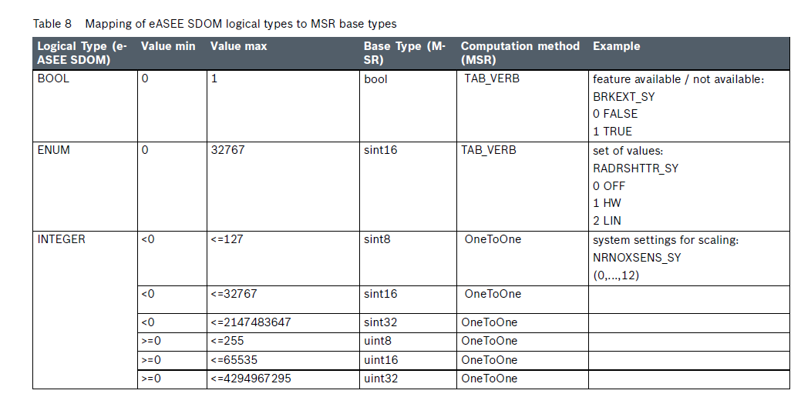
6.7.3.9 Good programming style
Why not use literal constants in system conditions?
To avoid overhead and in order to limit the huge number of system constants no extra fixed or stable system constants shall be requested at the central architecture clearing board.
Only the integer representation can be consistently used in different tools where system conditions have to be given. Consistence conditions are necessary to ease the verification of the conditions among several files and applications.

Slide 9
6.7.3.9 Good programming style
EX:
#if (RADRSHTTR_SY == CRCTL_LIN) /* NOT supported (literals are not supported in eASEE SDOM)
#if (BRKEXT_SY != FALSE) /* Not recommended
#if (BRKEXT_SY == TRUE) /* Not recommended

Slide 10
Thank you for listening!
18
RBVH/EJV3 | 2018-05-28
© Robert Bosch Engineering and Business Solutions Vietnam Company Limited 2018. All rights reserved, also regarding any disposal, exploitation, reproduction, editing, distribution, as well as in the event of applications for industrial property rights.

